Slide 1
RTA West and Airport Corridors: RTA Board Update
Prepared for the Regional Transportation Authority of Central Oklahoma Board of Directors
Prepared by Kimley-Horn and Associates
June 26, 2024

Slide 2
Topics
May Board Meeting Recap
Engagement Updates
LPA Recommendations
LRT/BRT Costs

Slide 3



Alternatives Analysis Process
Spring 2023
Define all reasonable alternatives
Screen against goals & objectives
DISCOVER
Advance remaining alternatives
Perform detailed technical analysis
REFINE
We are here!
LPA Selections
Board Consideration of LPA
SELECT
Summer 2024

Slide 4








Goals and Objectives
Mobility & Connectivity
Equity & Accessibility
Economic & Workforce Development
Sustainability & Viability
Direct connection to Santa Fe Intermodal Hub
Serves areas with high equity index
Serves areas with high activity index
Serves areas with high transit propensity
Serves major activity centers
Serves areas of persistent poverty
Connects to areas with projected growth
Utilizes existing infrastructure
Notes:
Goals as outlined in the 2021 RTA Transit System Plan
The objectives on the screen were adapted from those goals

Slide 5








Project Schedule
We are here!
2023
2024
Task
Board and TWG
Technical Work
Engagement Activities
Jun | Jul | Aug | Sep | Oct | Nov | Dec | Jan | Feb | Mar | Apr | May | Jun
Discover Phase
TWG & Board Meetings
Targeted Stakeholder Engagement
Refine Phase
Select Phase
Online Survey
Open House & Town Halls

Slide 6

May Board Meeting Recap
Notes:
A reminder of what Liz talked with ya’ll about in August

Slide 7
Journey to the LPAs
Initial assessment
REFINE
Town hall
Universe of alternatives
Stakeholder meetings
DISCOVER
Additional analysis
Stakeholder meetings
Town Hall
Detailed assessment
Town hall
Develop study areas
High potential alternatives
SELECT
Summer 2023
Summer 2024
7

Slide 8



Detailed Evaluation Process
Project Goals
20 Evaluation Criteria Based On Objectives
Comparative Outputs Based On Goals
Mobility & Connectivity
Sustainability & Viability
Equity & Accessibility
Economic and Workforce Development
Technical Working Group and Stakeholder Feedback

Slide 9

West Corridor

Slide 10
West Corridor Additional Analysis
West Corridor Alignment
Existing Transit Ridership Patterns | Not a differentiator
Analysis on Activities in Station Areas | Differentiator
Travel Time Analysis/Transit Speeds | Not a differentiator
Dedicated Guideway Considerations | Not a differentiator
Additional work to the 20 metrics in Detailed Evaluation

Slide 11
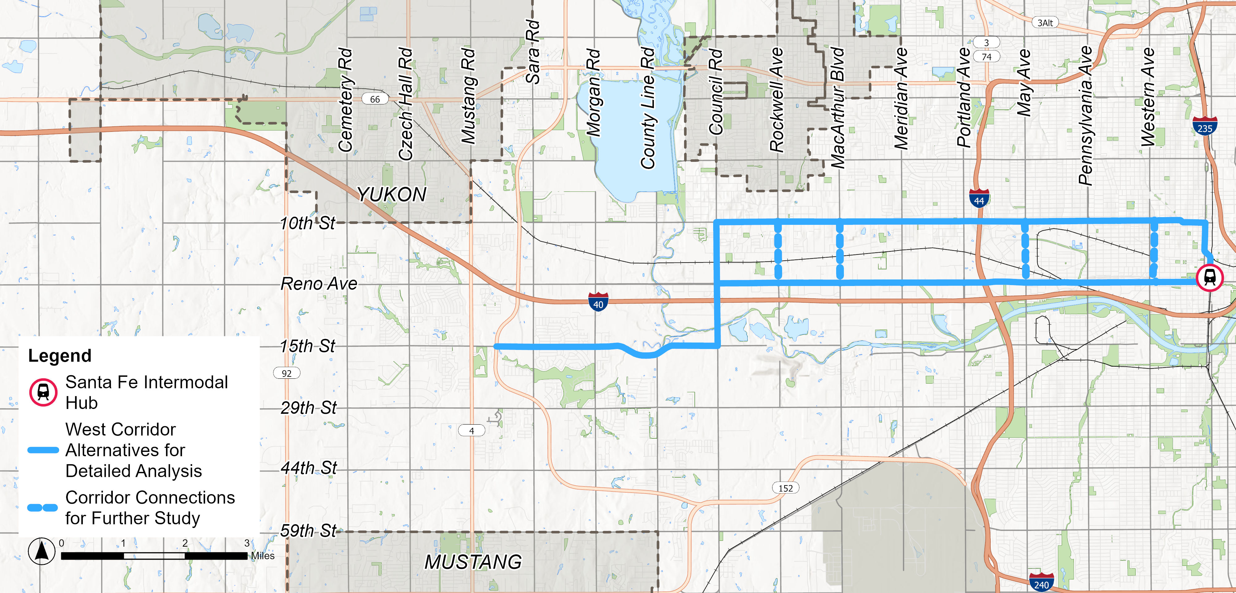
West Corridor Alternatives
W2

Slide 12
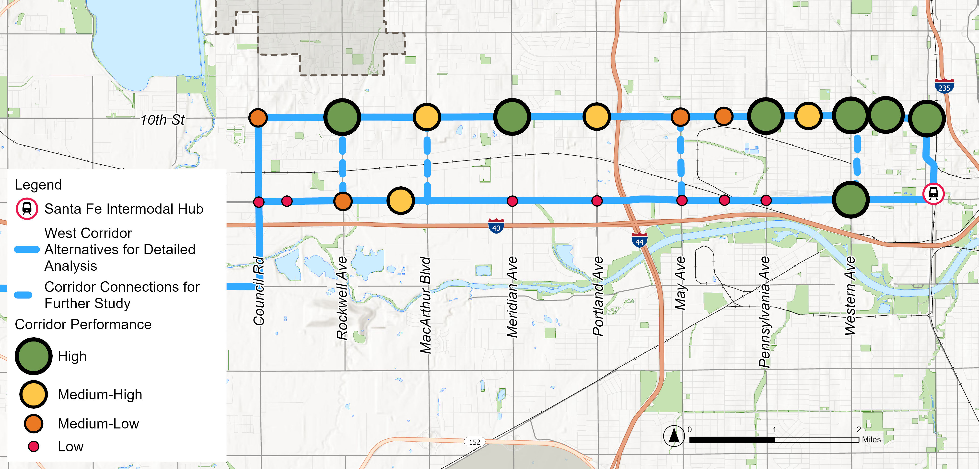
Alignment Refinement Considerations
Significant existing transit market on 10th Street

Slide 13
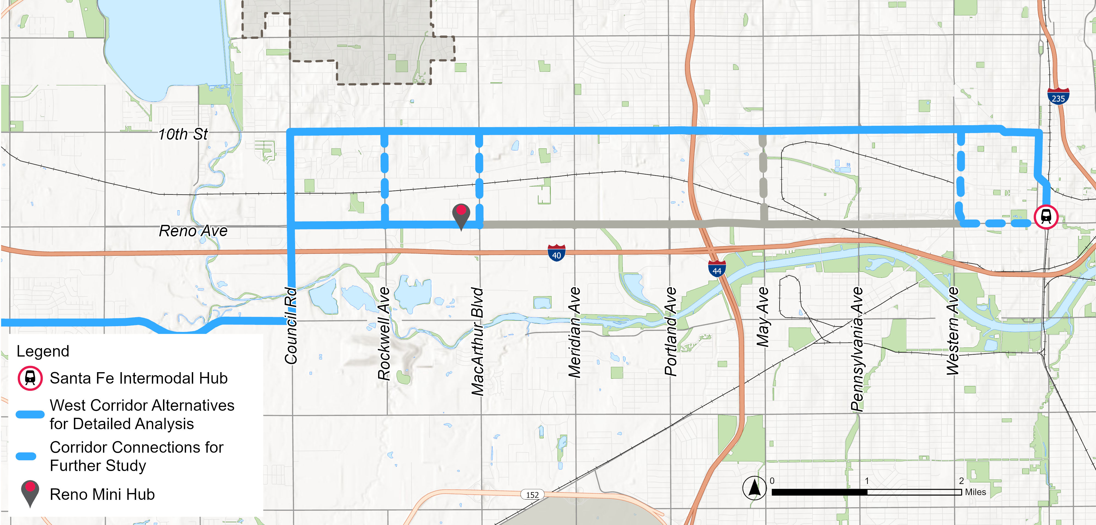

Alignment Refinement Considerations
Local bus transfer point at Reno Mini Hub

Slide 14
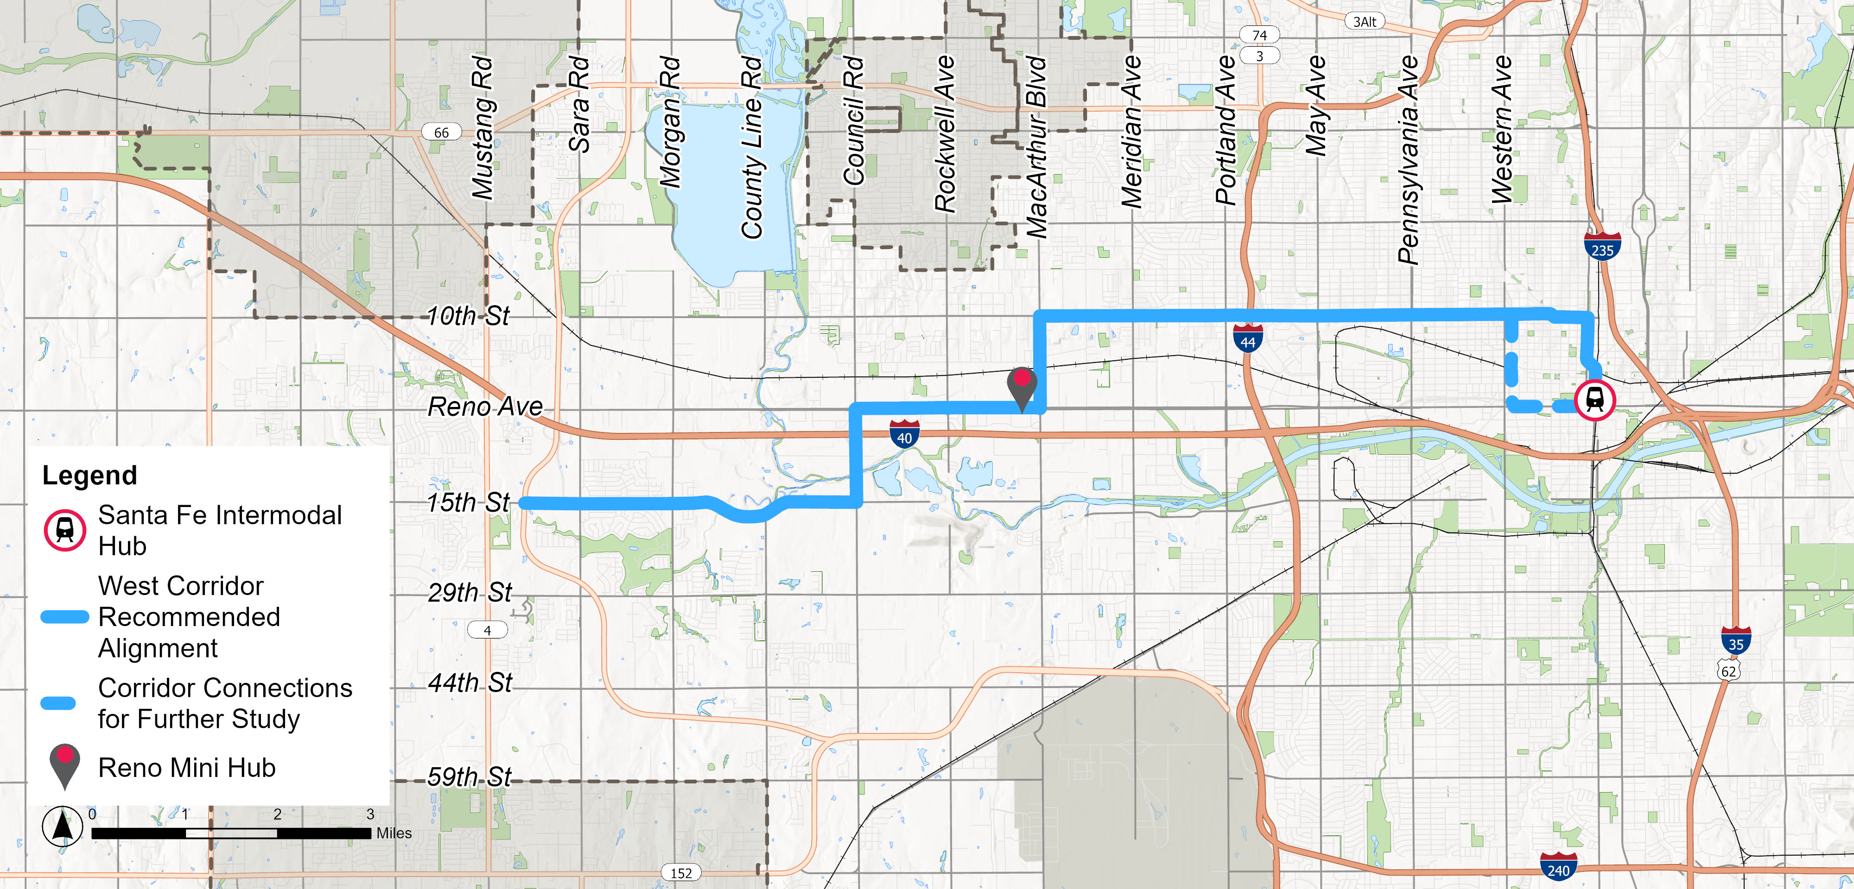
West Corridor Recommended Alignment

Slide 15
Dedicated Guideway: Challenges and Opportunities
Feasibility Scan
Constrained
Right-of-way
Bridge Structures
Sharp Turn
Highway Interchange
At-grade Railroad Crossing

Slide 16

Airport Corridor

Slide 17
Airport Corridor Additional Analysis
Airport Corridor Alignment
Existing Transit Ridership Patterns | Not a differentiator
Analysis on Activities in Station Areas | Not a differentiator
Existing Trips Between Station Areas | Differentiator
Travel Time Analysis/Transit Speeds | Not a differentiator
Dedicated Guideway Considerations | Differentiator
Additional work to the 20 metrics in Detailed Evaluation

Slide 18
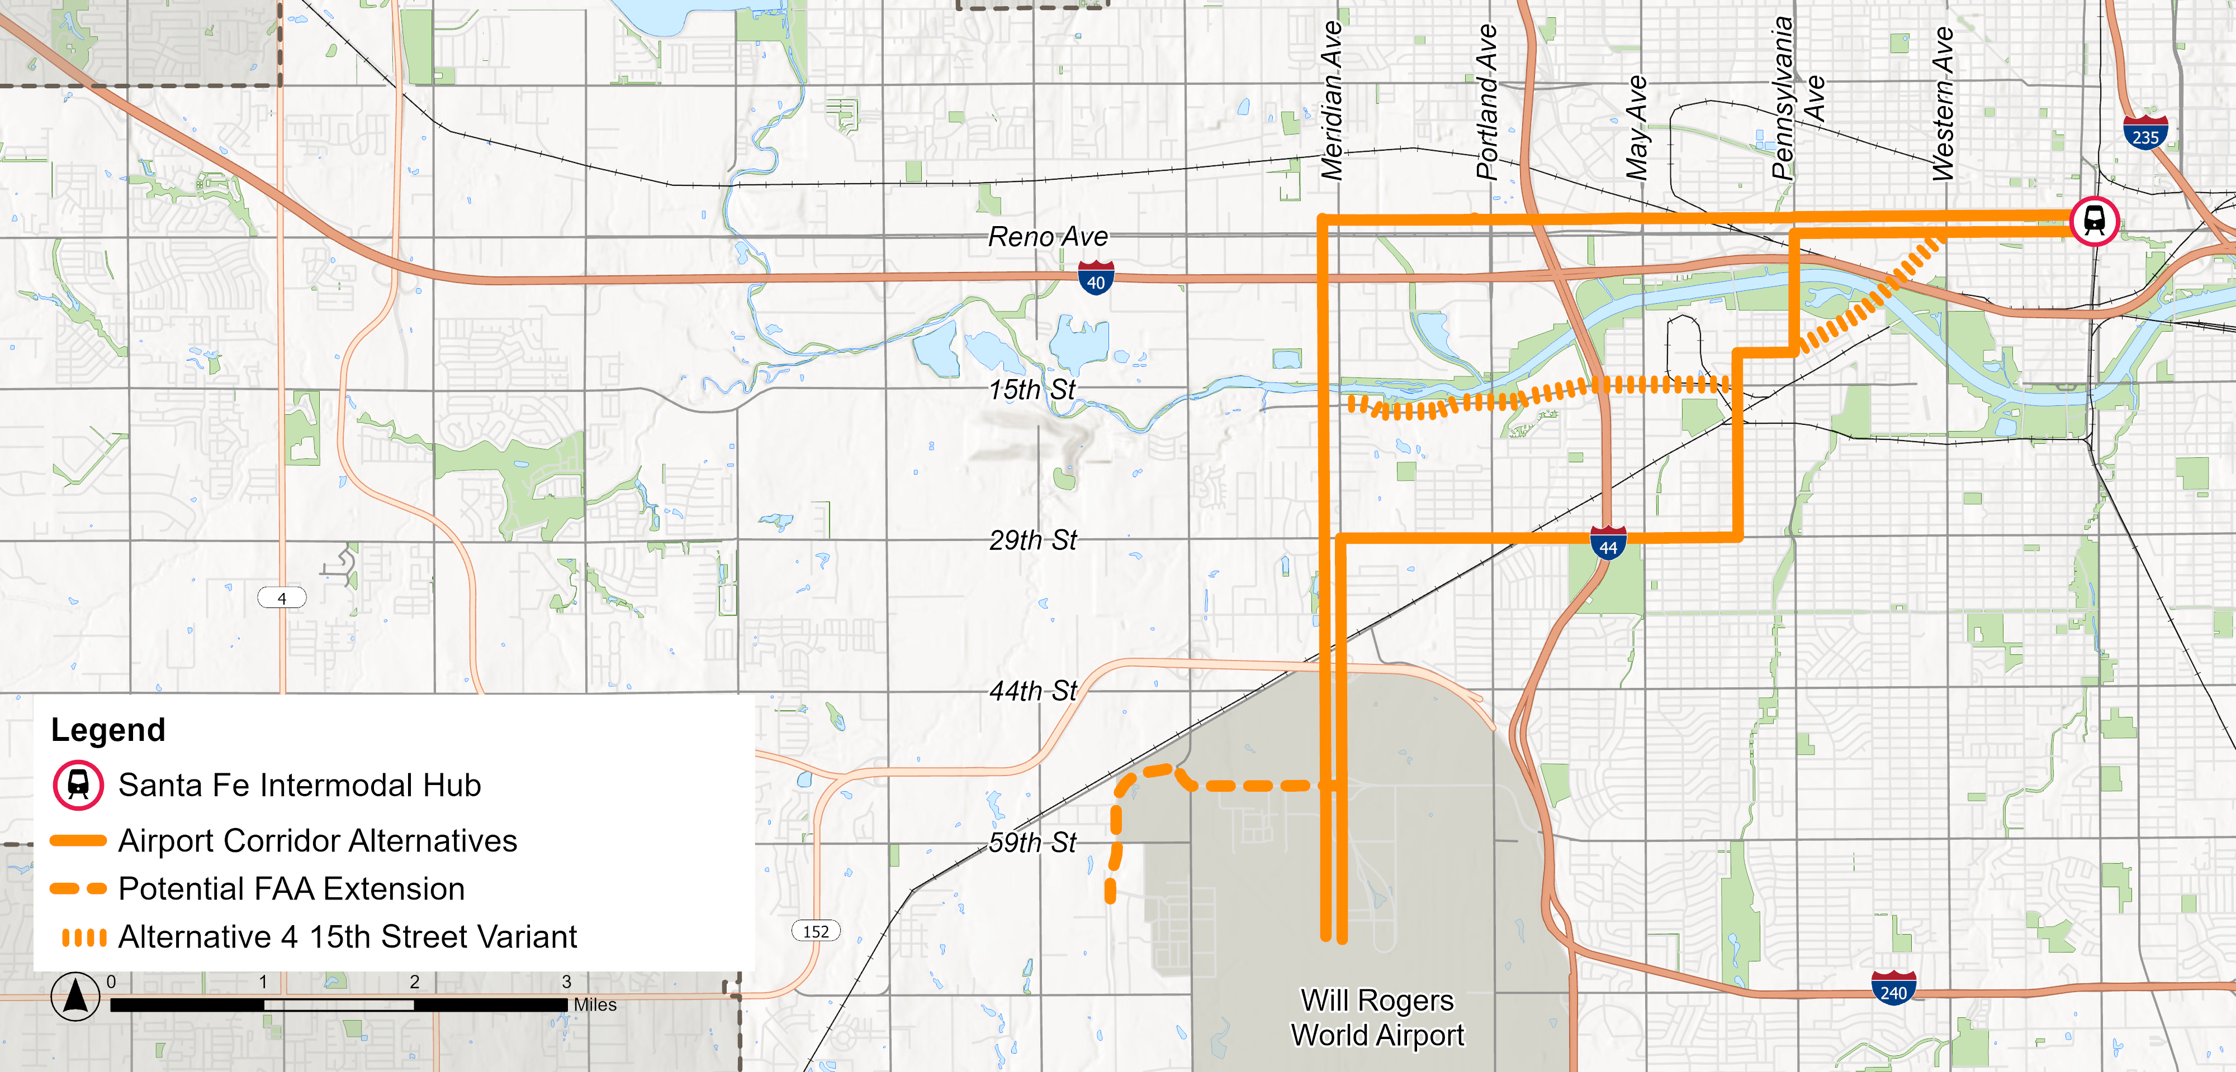

Airport Corridor Alternatives
A1
A4

Slide 19
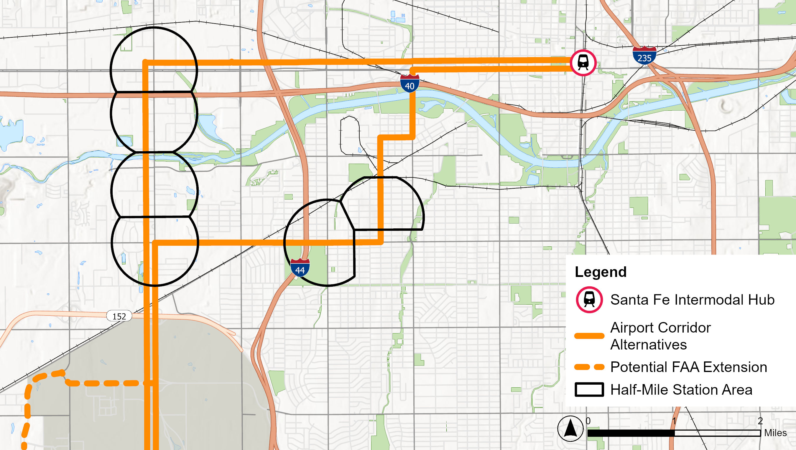




Existing Travel Patterns – Top Station Area Pairs
A1
A4
Will Rogers World Airport
Notes:
We don’t have the data to fully confirm this but:
Given the types of locations on Meridian, we think that a lot of these trips are people who don’t live or work in OKC
High concentration of trips by visitors
Daily Trips Agnew @ 25th to 29th @ May – 360 Daily Trips
Meridian @ 20th to Will Rodgers World Airport – 300 Daily Trips
Meridian @ Will Rodgers Pkwy to Will Rodgers World Airport – 280 Daily Trips
Meridian @ Will Rodgers Pkwy to Meridian @ 29th – 280 Daily Trips
Reno @ Meridian to Meridian @ 20th – 250 Daily Trips

Slide 20
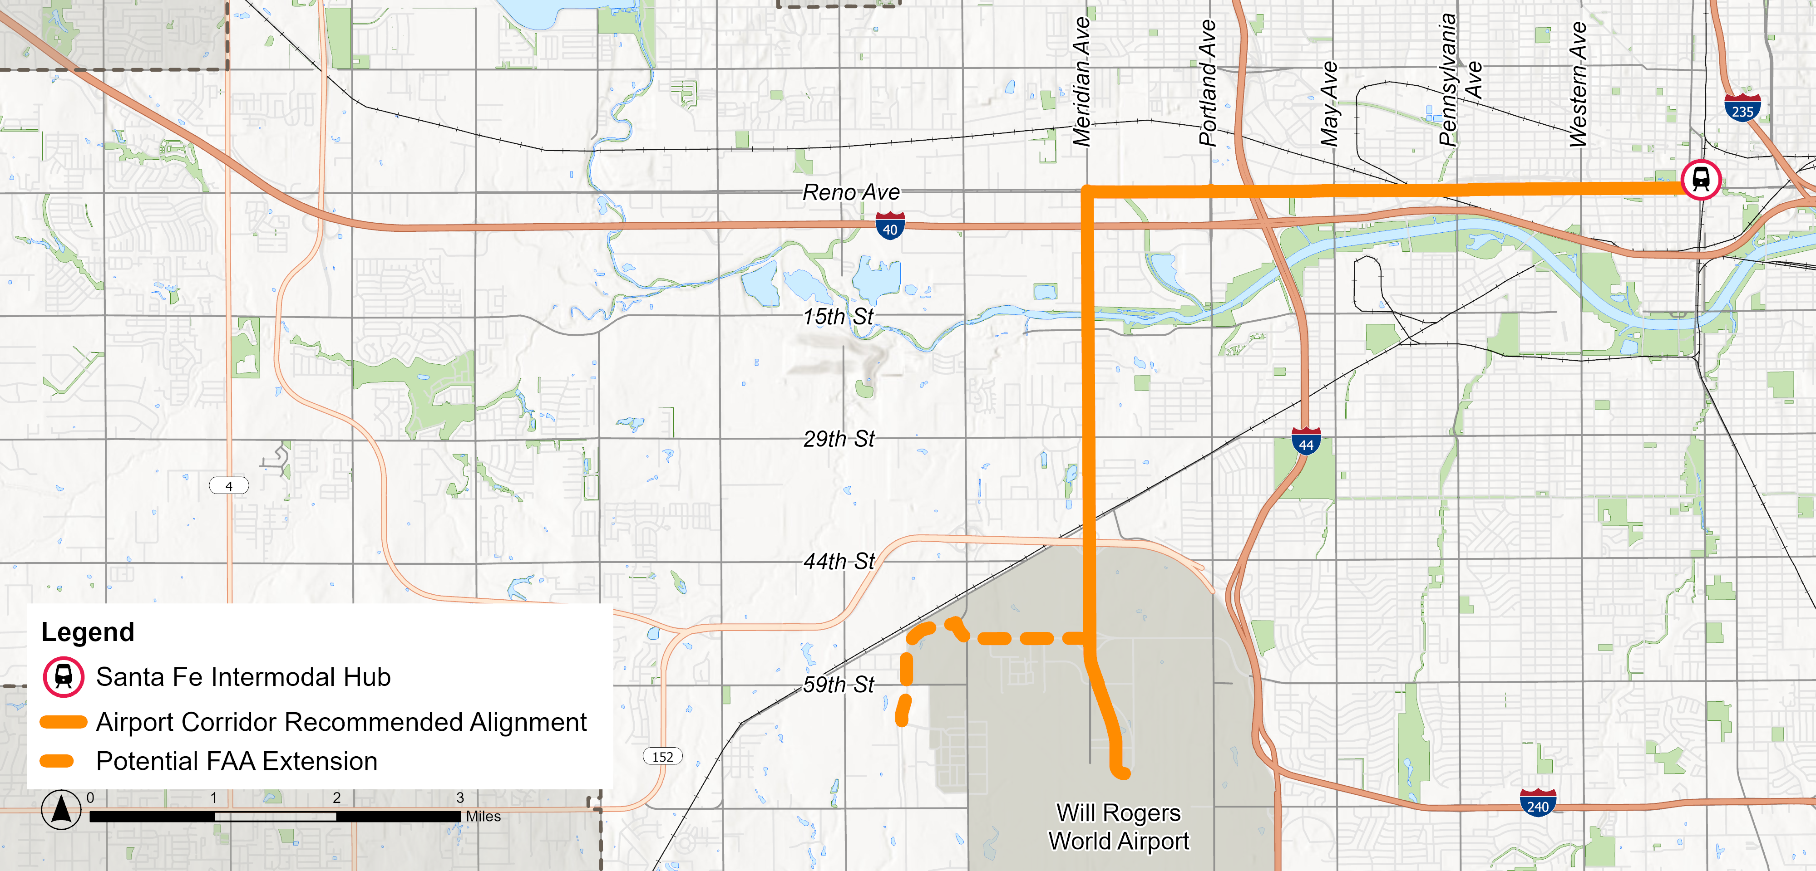
Recommended Alignment
A1

Slide 21
Dedicated Guideway: Challenges and Opportunities
Feasibility Scan
Constrained
Right-of-way
Bridge Structures
Sharp Turn
Highway Interchange
At-grade Railroad Crossing

Slide 22
FAA Extension Service Options
Option 1:
Regular Service
Option 2:
Deviated Service Pattern
Option 3:
Shuttle Connector Service
FAA
FAA
FAA
Airport
Airport
Airport
All trips serve both Airport and FAA
Requires additional investment in guideway and stations
Longer trip times
Some trips go to Airport/some go to FAA
Requires additional investment in guideway and stations
Reduced frequency to Airport, can introduce rider confusion
FAA Complex served by a shuttle service from an RTA Station
Less additional investment in guideway and stations
Not a one-seat-ride for FAA employees

Slide 23

Engagement Updates

Slide 24
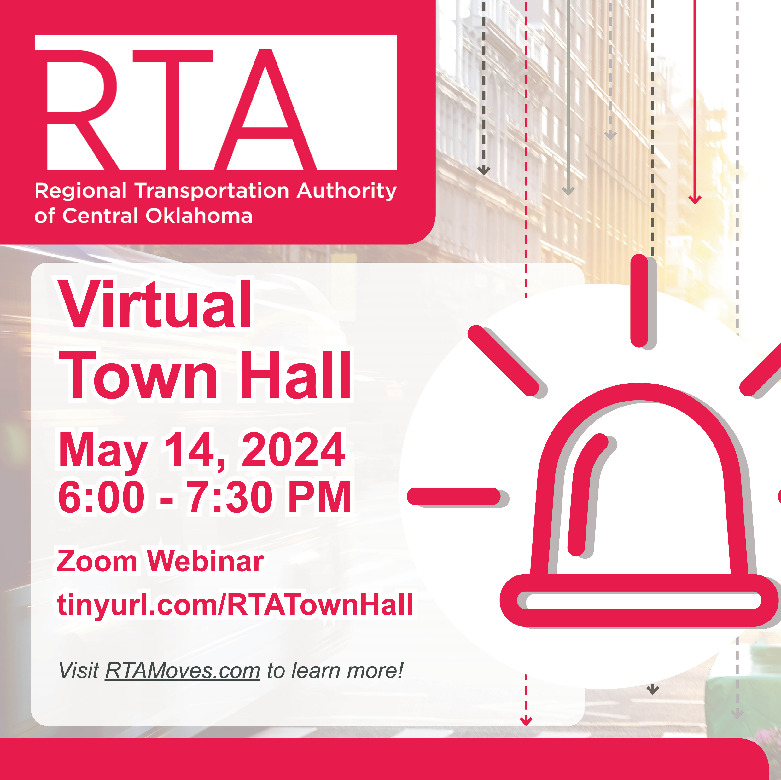
Virtual Town Hall Recap
May 14, 2024 on Zoom
Total of 61 views (9 live viewers and 57 views of recording)
Presented Recommended LPAs
Live Question and Answer Session included questions received online prior to Virtual Town Hall
Recording of Town Hall posted online following event
Notes:
Deliver project updates and analysis
Introduce high-potential alignments
Gauge public sentiment before full evaluation of alternatives

Slide 25
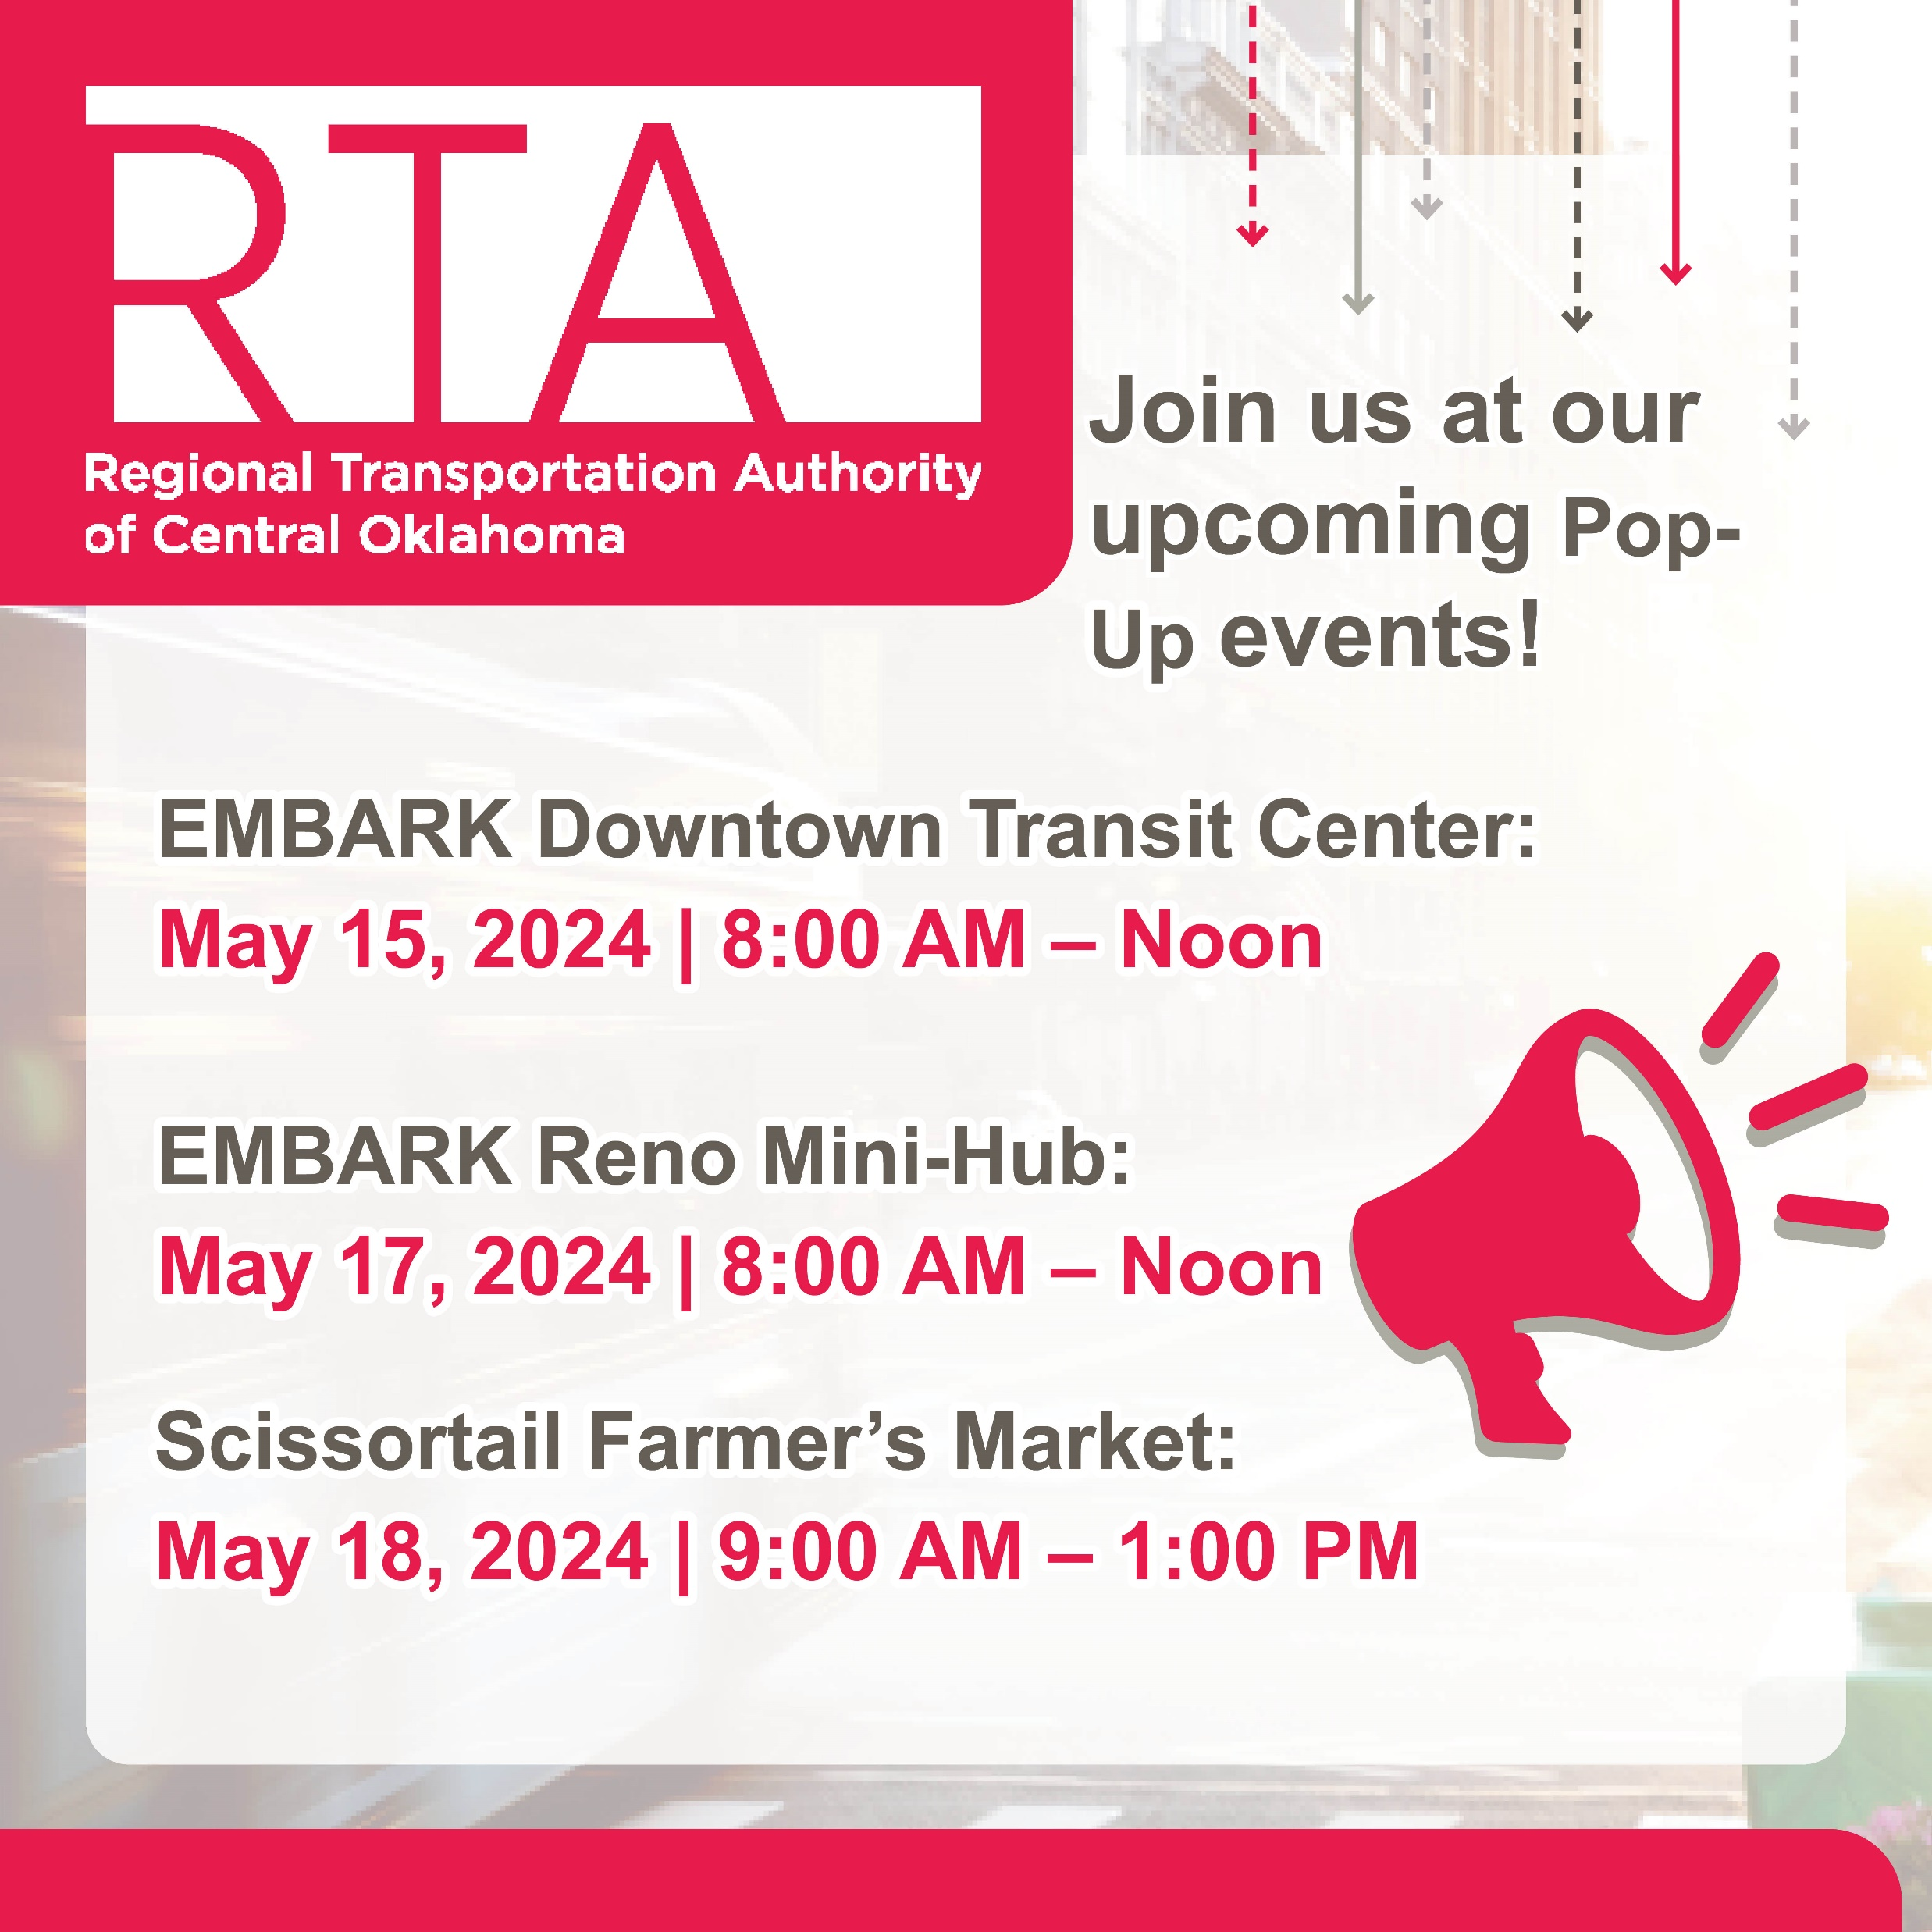
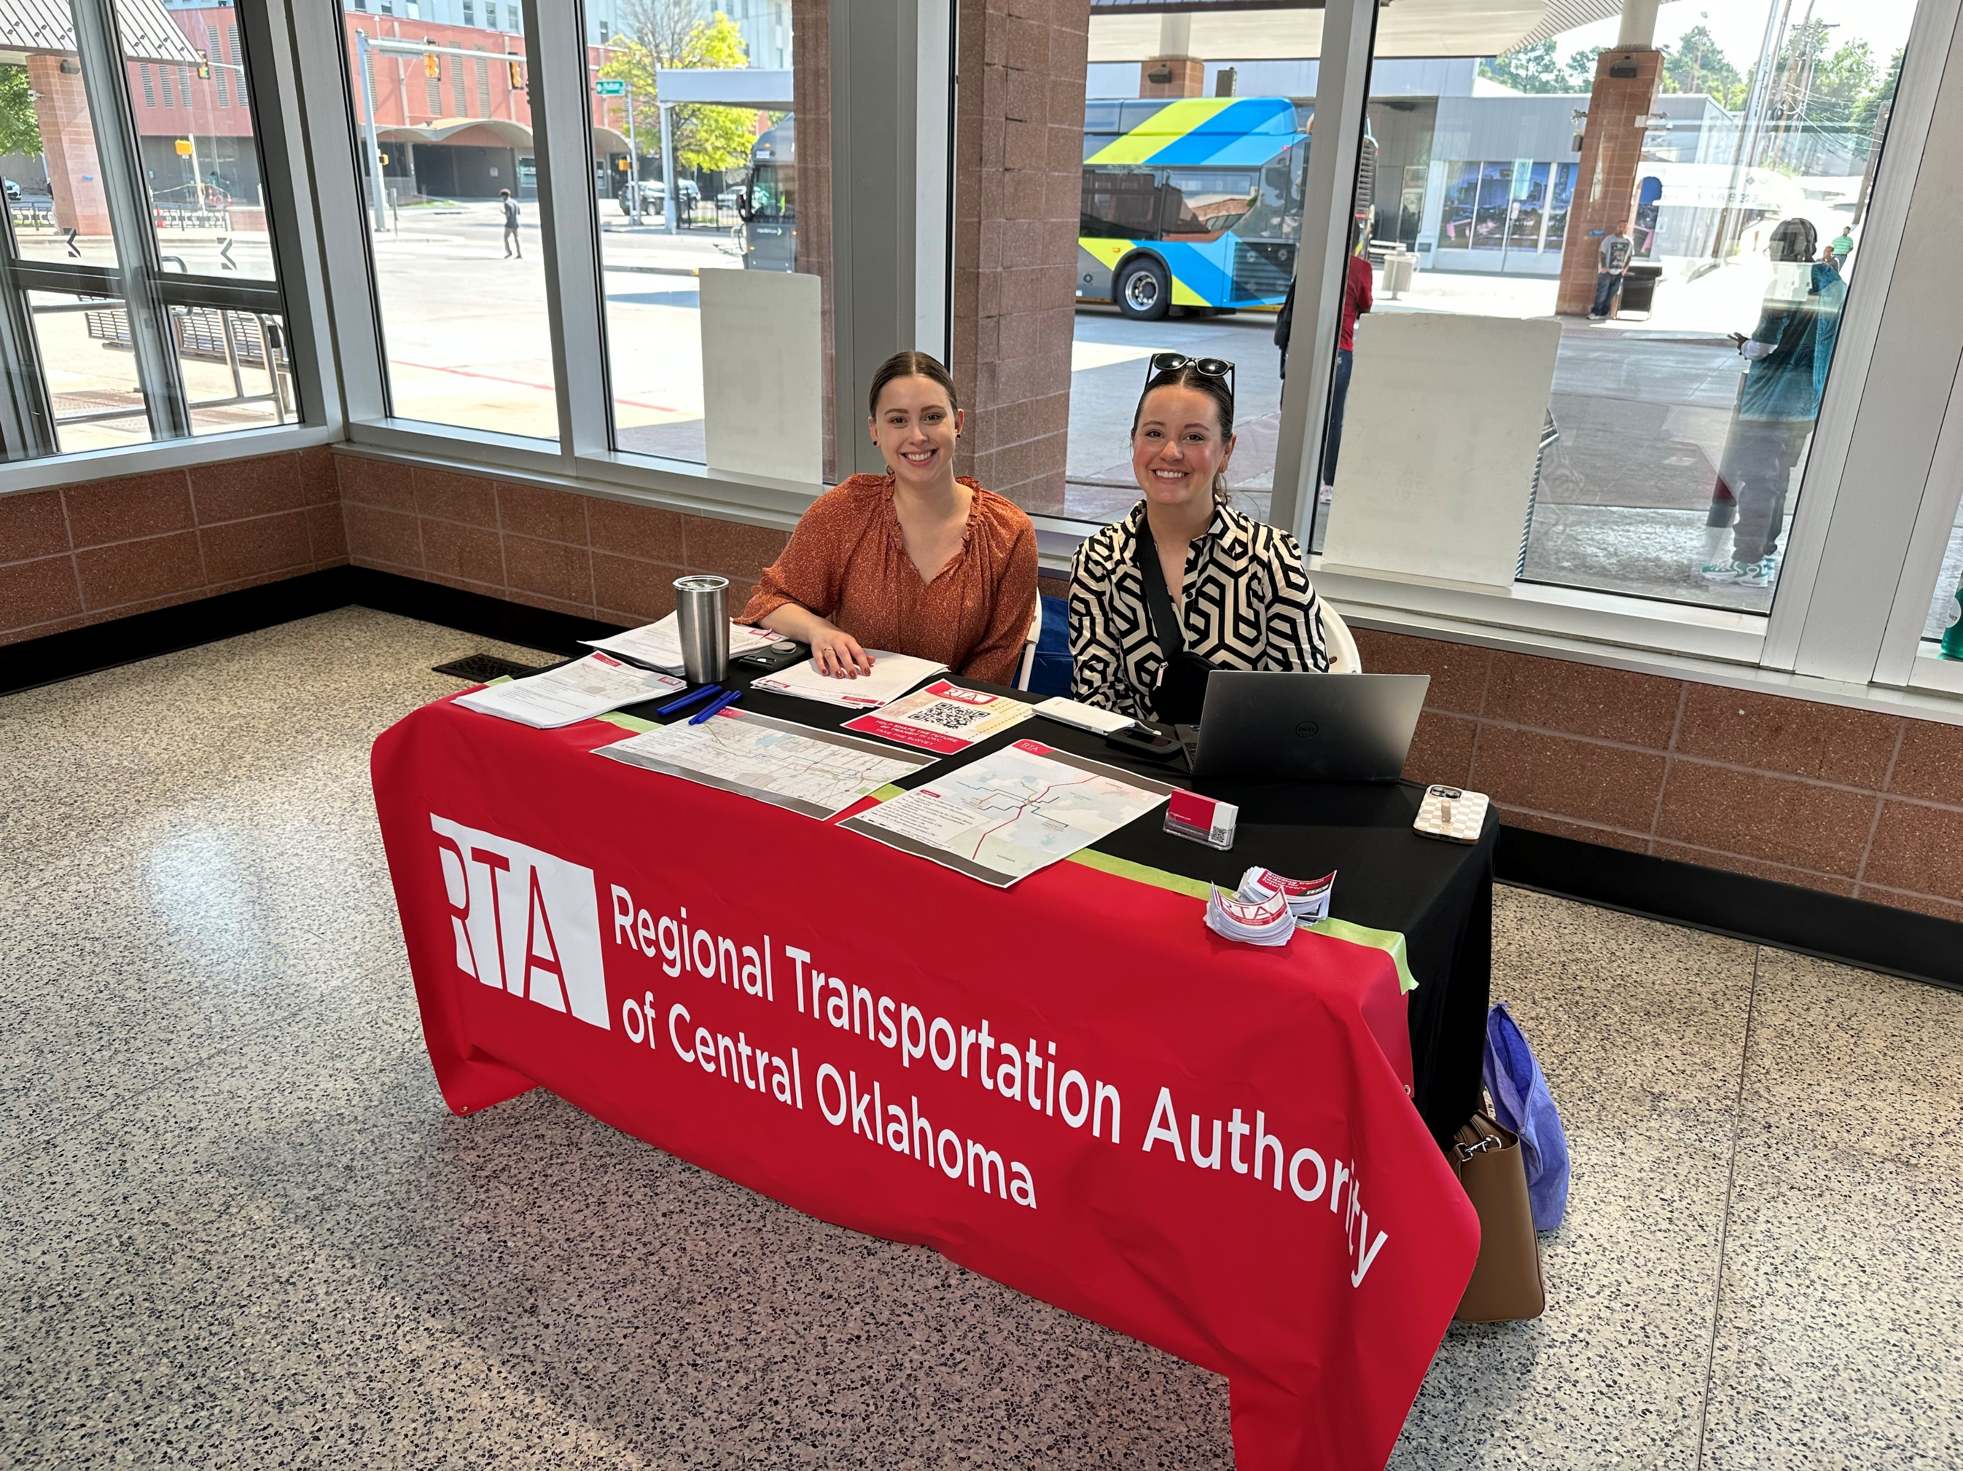
In-Person Events
Notes:
Talked with about 125 community members at the in-person events

Slide 26
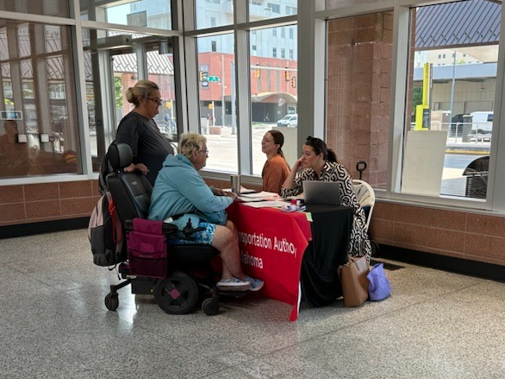
Engagement Recap
Three pop-up events
13 Stakeholder Interviews
170 Survey Responses (120 Virtual and 50 Paper)
3,036 Engagements on RTA’s social media accounts May 1 - 31 (including views, clicks, shares, likes, and comments)
Online Comment Box to promote accessibility and accept questions before and after Town Hall (four comments received)
Notes:
Fantastic attendance – we were thrilled with this. Lots of online engagement

Slide 27






Public Engagement Takeaways
Provide strong links to other transit routes
Make connections to the bike and pedestrian network
Make transit attractive, modern, and safe
Balance station frequency with quick travel times
Reduce congestion
Extend service hours to benefit early morning and late-night airport users

Slide 28










Stakeholder Coordination
OKC Outlets
Stockyards City
OKC Housing
Authority
Alliance for Economic Development
OKC Fairgrounds
Will Rogers World Airport
Visit OKC
Greater OKC
Chamber
Hispanic Chamber
of Commerce
Mike Monroney
Aeronautical Center

Slide 29





General support for the recommended LPAs on both the West and Airport Corridor
Enthusiasm about the economic development potential of LRT on the Airport Corridor
Stakeholders view NW RAPID as a success – see similar potential for the West Corridor
Many questions about the potential for transfers between regional transit services at the Santa Fe Intermodal Hub
Stakeholder Meeting Takeaways

Slide 30
FAA Coordination
Option 1:
Regular Service
Option 2:
Deviated Service Pattern
Option 3:
Shuttle Connector Service
FAA
FAA
FAA
Airport
Airport
Airport
All trips serve both Airport and FAA
Requires additional investment in guideway and stations
Longer trip times
Some trips go to Airport/some go to FAA
Requires additional investment in guideway and stations
Reduced frequency to Airport, can introduce rider confusion
FAA Complex served by a shuttle service from an RTA Station
Less additional investment in guideway and stations
Not a one-seat-ride for FAA employees

Slide 31

Average Peer Capital Costs

Slide 32
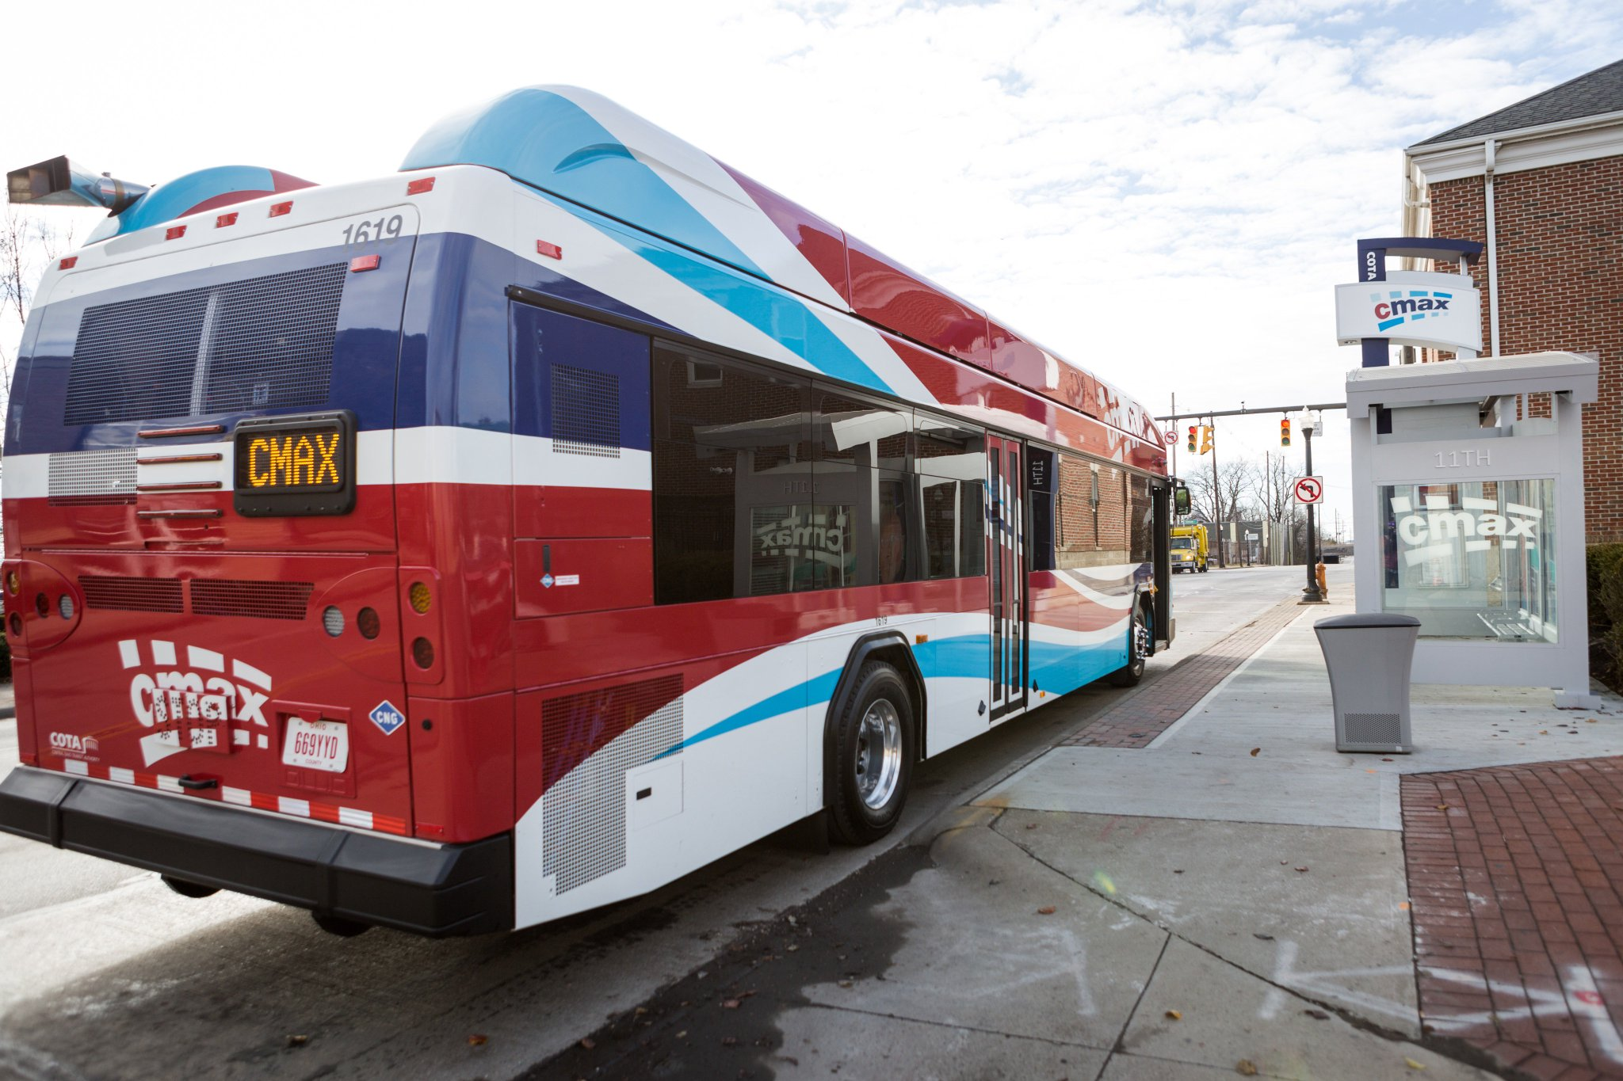
Average Capital Costs Based on Peers
Mixed-Traffic
Bus Rapid Transit
Commuter Rail
Peer Mixed-Traffic BRT
Avg. Cap Cost/mile
$8M

Slide 33
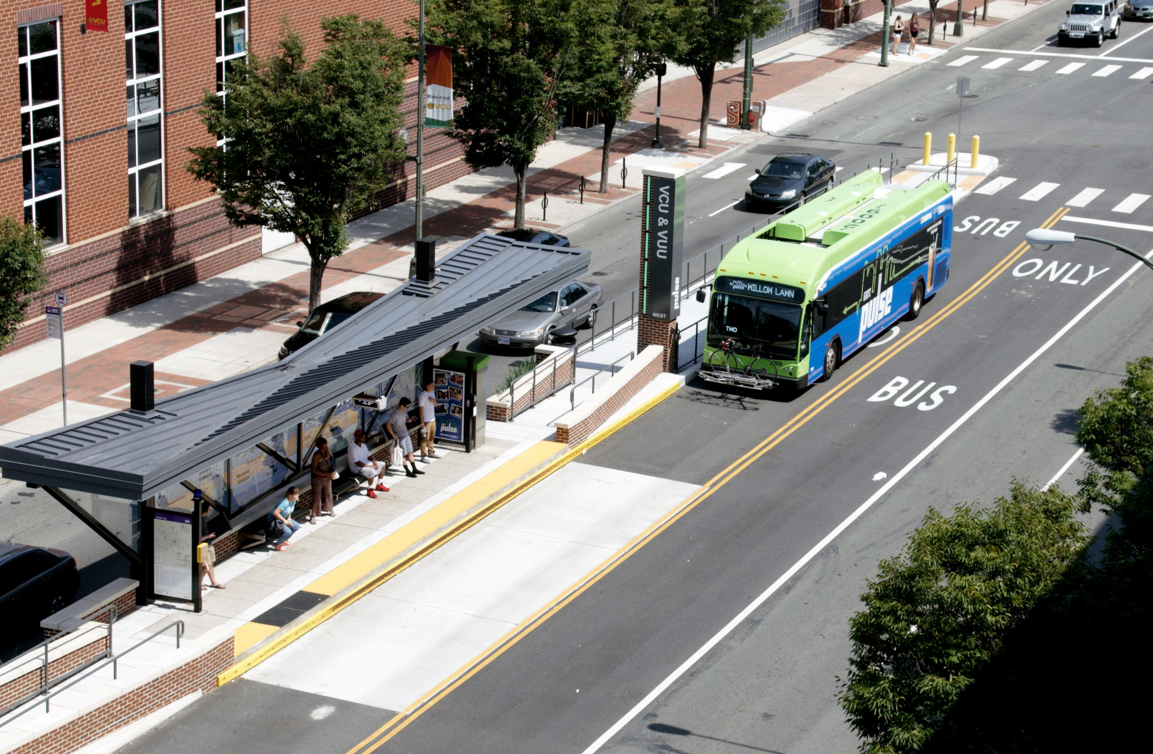
Average Capital Costs Based on Peers
Mixed-Traffic
Bus Rapid Transit
Dedicated Guideway
Bus Rapid Transit
Commuter Rail
Peer Mixed-Traffic BRT
Avg. Cap Cost/mile
$8M
Peer Dedicated Guideway BRT
Avg. Cap Cost/mile
$51M

Slide 34
Average Capital Costs Based on Peers
Mixed-Traffic
Bus Rapid Transit
Dedicated Guideway
Bus Rapid Transit
Commuter Rail
Peer Mixed-Traffic BRT
Avg. Cap Cost/mile
$8M
Peer Dedicated Guideway BRT
Avg. Cap Cost/mile
$51M
BRT projects must have at least 50% guideway dedication to be eligible for FTA Capital Funding Programs

Slide 35
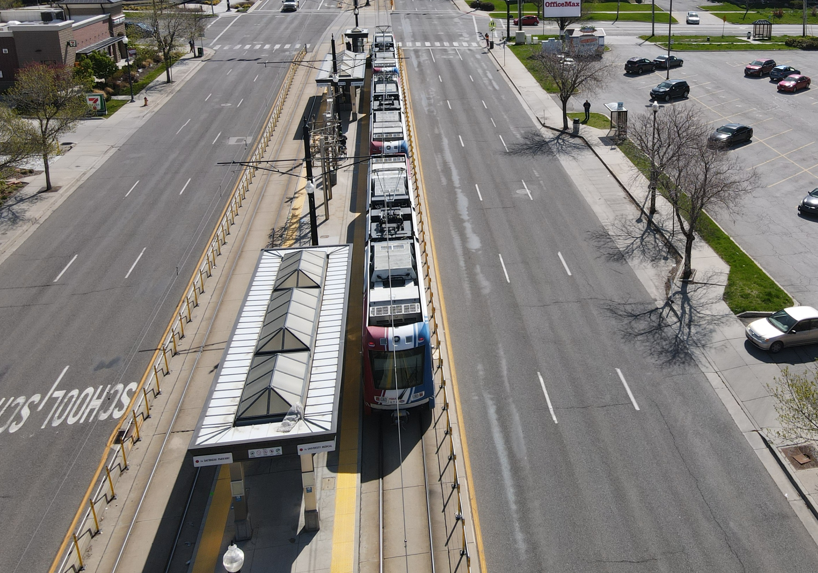
Average Capital Costs Based on Peers
Mixed-Traffic
Bus Rapid Transit
Dedicated Guideway
Bus Rapid Transit
Light Rail
Commuter Rail
Peer Mixed-Traffic BRT
Avg. Cap Cost/mile
$8M
Peer Dedicated Guideway BRT
Avg. Cap Cost/mile
$51M
Peer LRT
Avg. Cap Cost/mile
$125M
BRT projects must have at least 50% guideway dedication to be eligible for FTA Capital Funding Programs

Slide 36
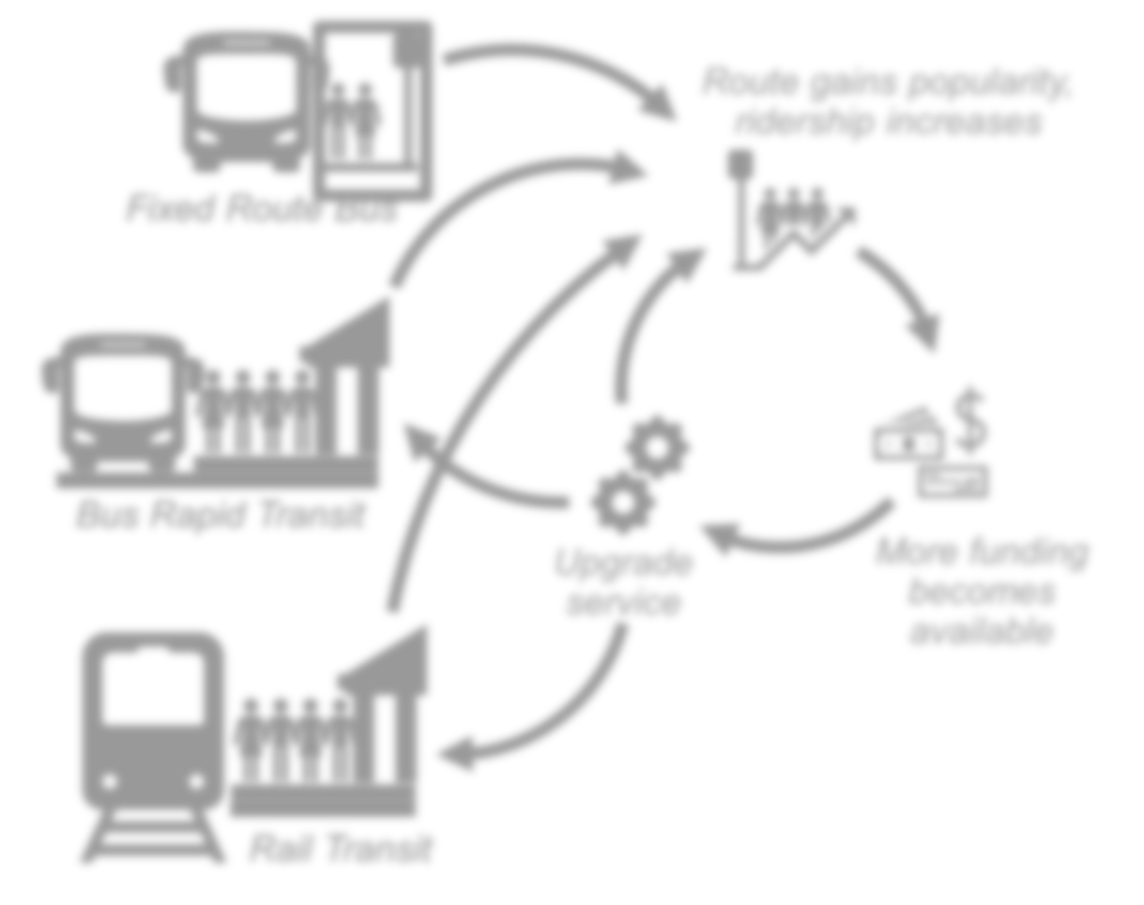
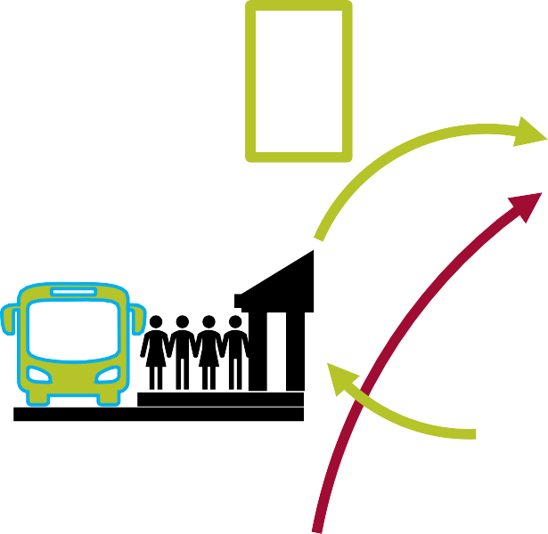

Transition from BRT to Rail Transit
BRT Investment
Growth in ridership opportunity
Establish a transit culture
Route gains popularity,
ridership increases
Spur economic growth along corridor
Does Not Preclude Rail
As ridership grows and funding is
available
Ability to leverage an existing RR
corridor
Fixed Route Bus
Bus Rapid Transit
Upgrade service
More funding becomes available
Rail Transit

Slide 37

LPA Recommendations

Slide 38


Locally Preferred Alternative
Alignment – where the transit will go
Mode – Transit vehicle type

Slide 39
What is a Locally Preferred Alternative
Community’s preferred mode and alignment that meets identified goals and objectives
LPA identifies:
LPA does not:
Feasible alignment
Mode
Planning level information (i.e., cost and ridership estimates)
Result in a fully designed system
Preclude modifications to alignments, modes, and stations

Slide 40
West Corridor LPA Recommendation
Mode: BRT
Notes:
There is no service past council rd

Slide 41
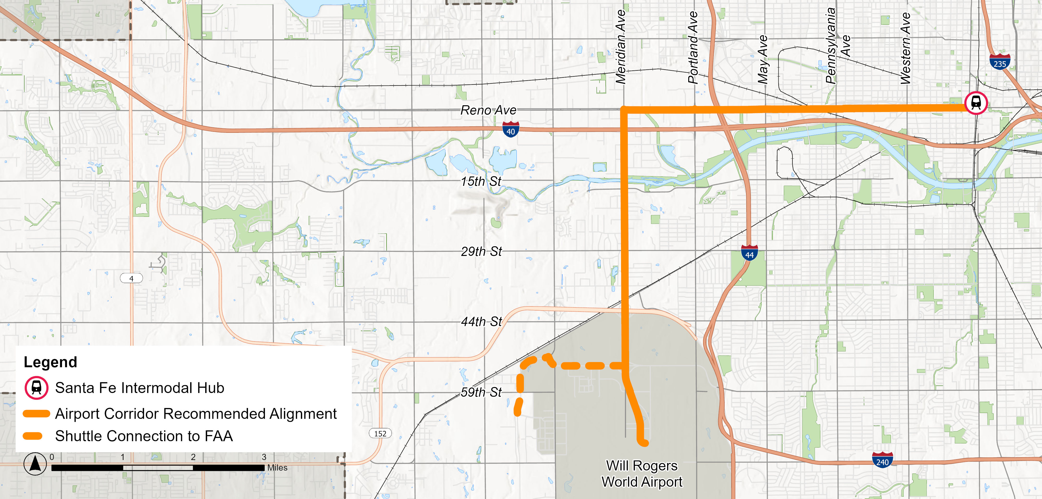

Airport Corridor LPA Recommendation
Mode: LRT
Mode: LRT

Slide 42

Next Steps

Slide 43
Next Steps
Alternatives Analysis Documentation
Transit System Plan Update
Project Closeout

Slide 44

Thank You

